Slide 1
Study Source
Alice, Mark, Florent, Daniel

Slide 2
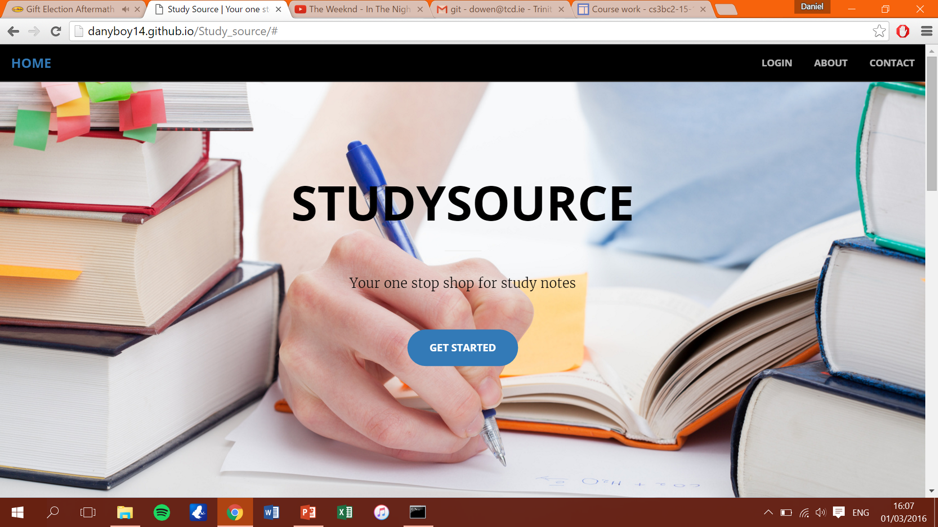
Website address: danyboy14.github.io/Study_source
This is our website hosted on Github which is in its present state online.

Slide 3
Features in place
A home page.
Our website fully supports new users who are looking to sign up to the service.
We have a section for Leaving Cert notes and one for College notes, which allows users to browse our library of notes by topic, and also to search for the notes they want

Slide 4
Features yet to be implemented
Allow users to upload notes
Allow users to purchase notes
Allow users to rate notes purchased

Slide 5
Evaluation of design
Our website from the start shows exactly what is being sold and the user can see this clearly.
An elegant and aesthetically pleasing layout.
Can be ran on both mobile and desktop browsers.
Content is going to be easy to find with the use of out browse function.

Slide 6
Problems encountered so far
We are still trying to link our domain name (studysource.eu) to our repository.
Finding a server to host our database rather than hosting it locally.

Slide 7
Plan for completing the application

